Slide 1
Lecture 21: Subdivision Surfaces, Implicit Surfaces
COMPSCI/MATH 290-04
Chris Tralie, Duke University
3/31/2016

Slide 2
Announcements
1 Free Late Day on Group Assignment 1
Final Project Milestone Monday 4/11 (Hard Deadline, No Late Days)
Group Assignment 3 Out Sometime Next Week

Slide 3
Cosine Distance

Slide 4
Table Of Contents
1. Half Edge
2. Subdivision Surfaces
3. Implicit Surfaces

Slide 5
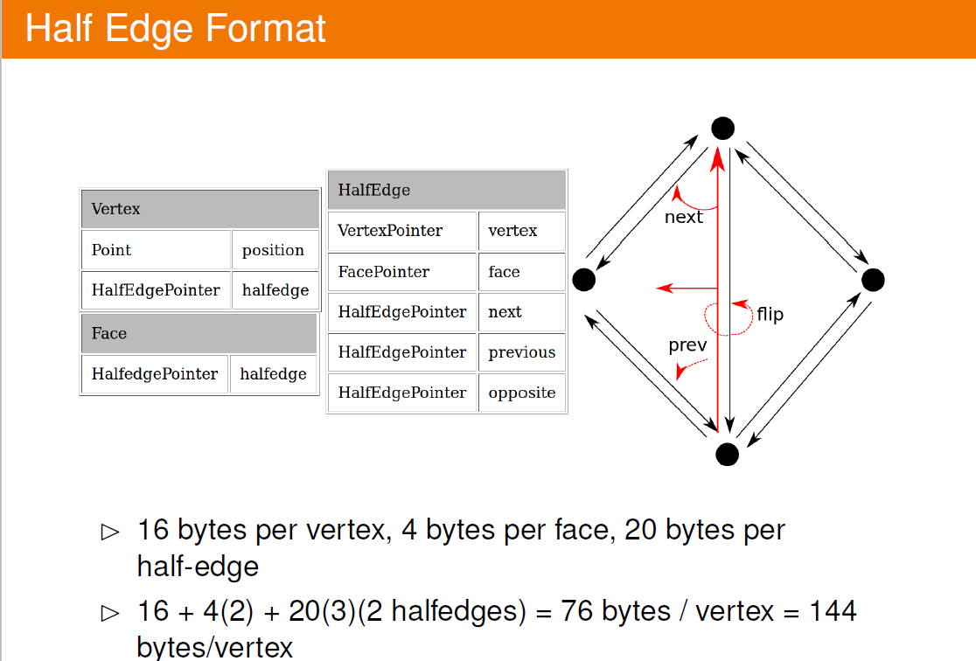

Slide 6
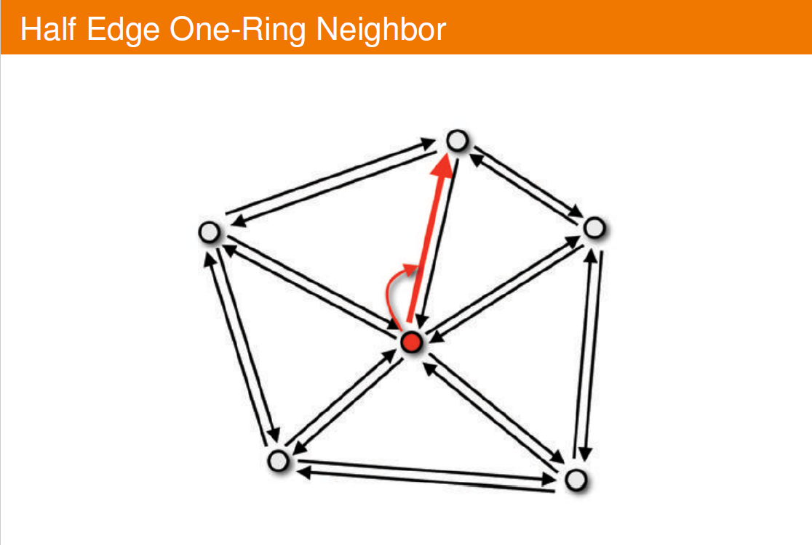

Slide 7
Table Of Contents
1. Half Edge
2. Subdivision Surfaces
3. Implicit Surfaces

Slide 8
Table Of Contents
1. Half Edge
2. Subdivision Surfaces
3. Implicit Surfaces

Slide 9
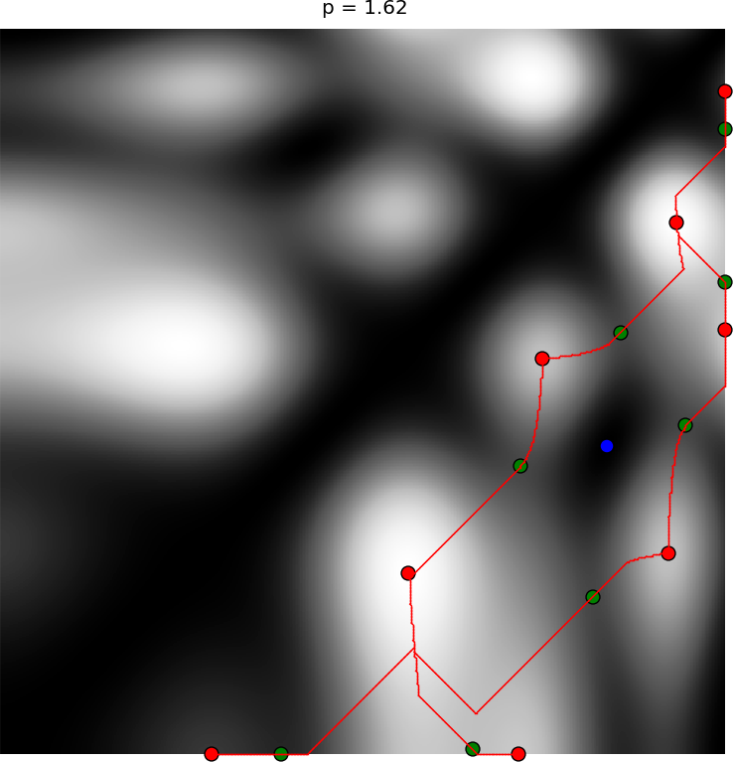
Functions on the Plane

Slide 10
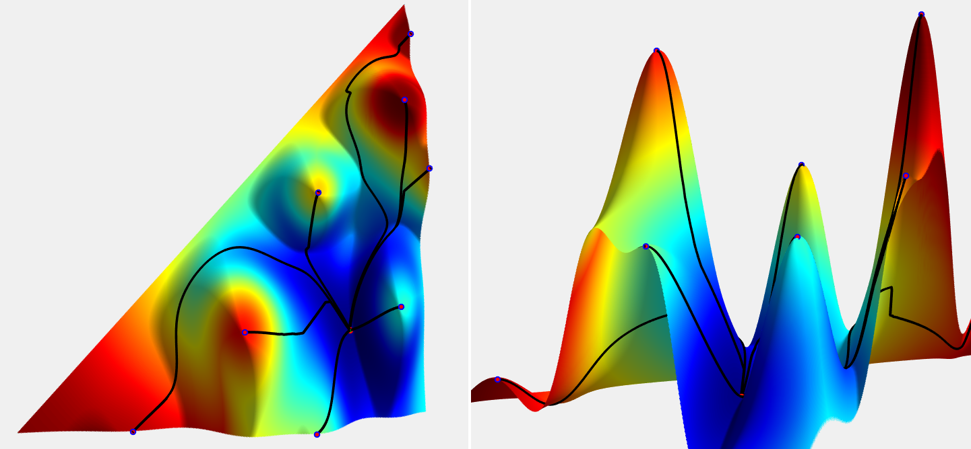
Functions on the Plane

Slide 11
Implicit Functions / Level Sets

Slide 12
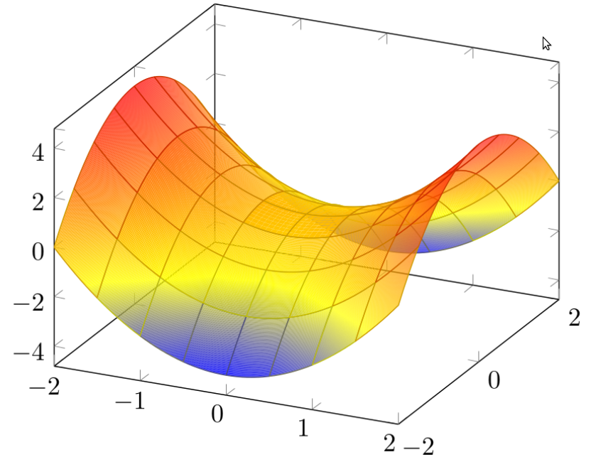
Saddle
http://sandrocirulli.net/tag/saddle-surface/

Slide 13
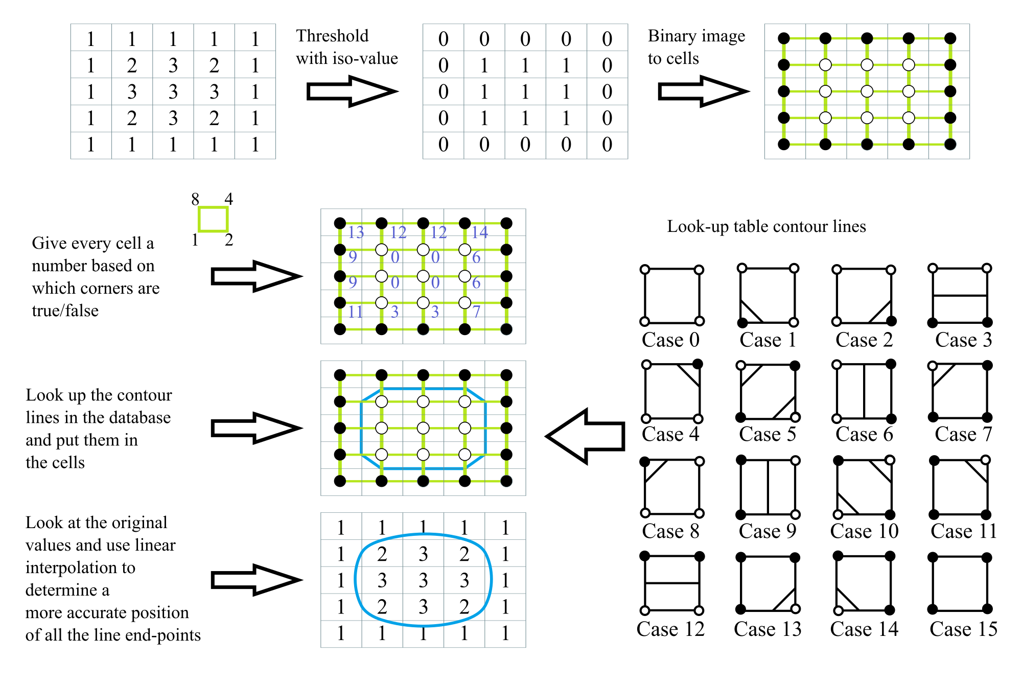
Marching Squares
https://en.wikipedia.org/wiki/Marching_squares

Slide 14
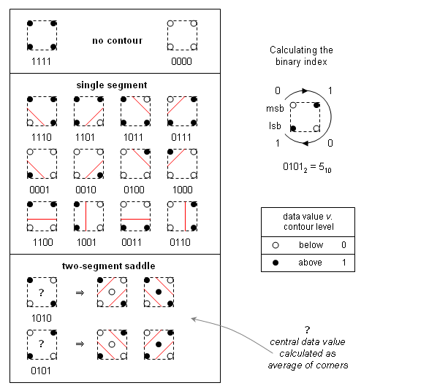
Saddle Point Ambiguity
https://en.wikipedia.org/wiki/Marching_squares

Slide 15

2D Sines Marching Squares
cos(2x + 4y) + cos(2x - 4y)

Slide 16
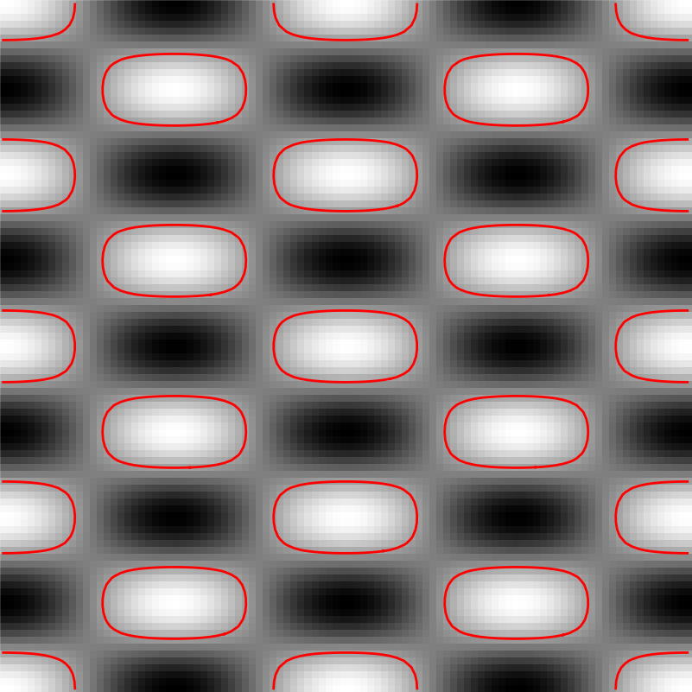
2D Sines Marching Squares
cos(2x + 4y) + cos(2x - 4y)

Slide 17
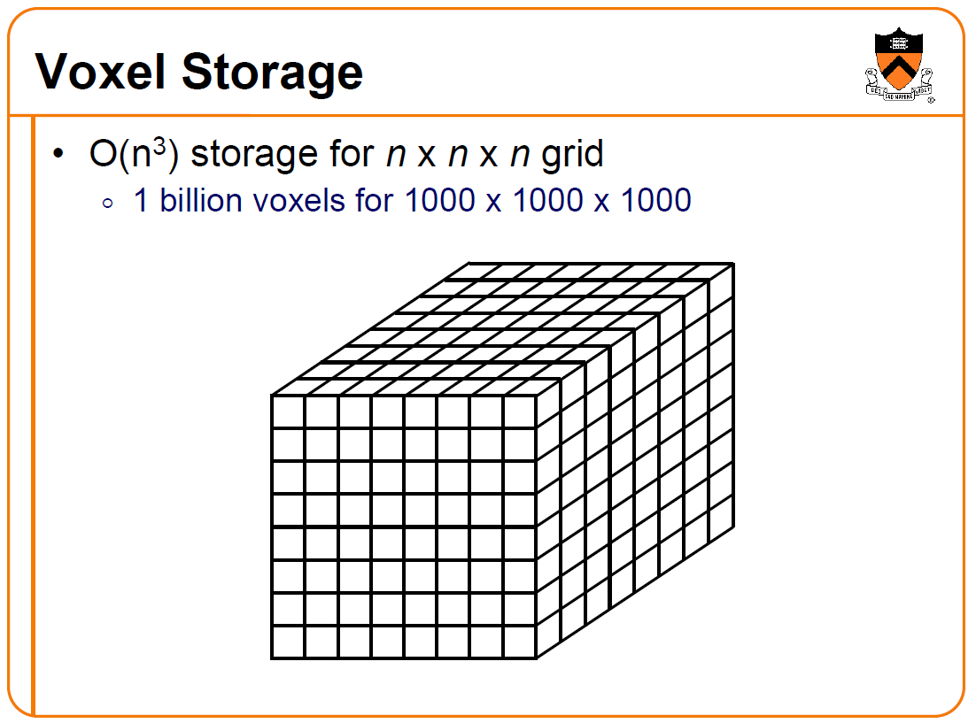
T. Funkhouser

Slide 18
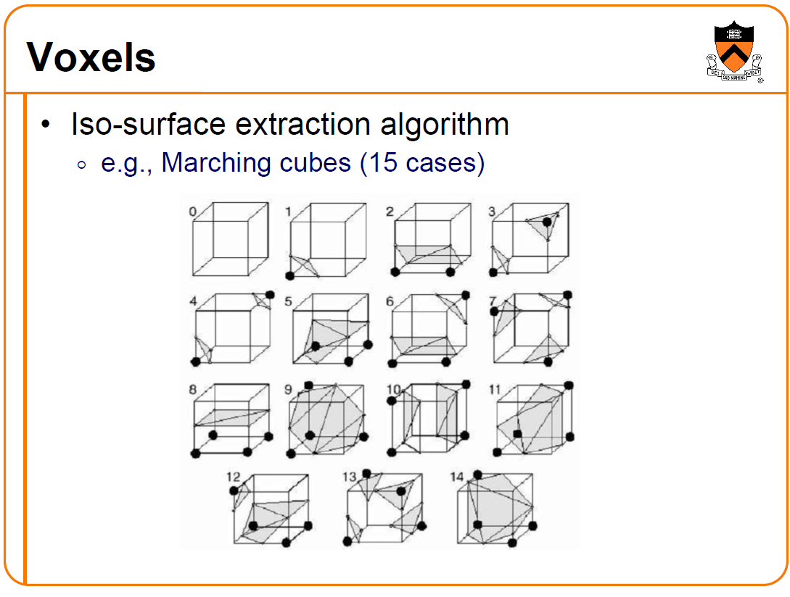
T. Funkhouser, Lorensen/Cline ‘87

Slide 19
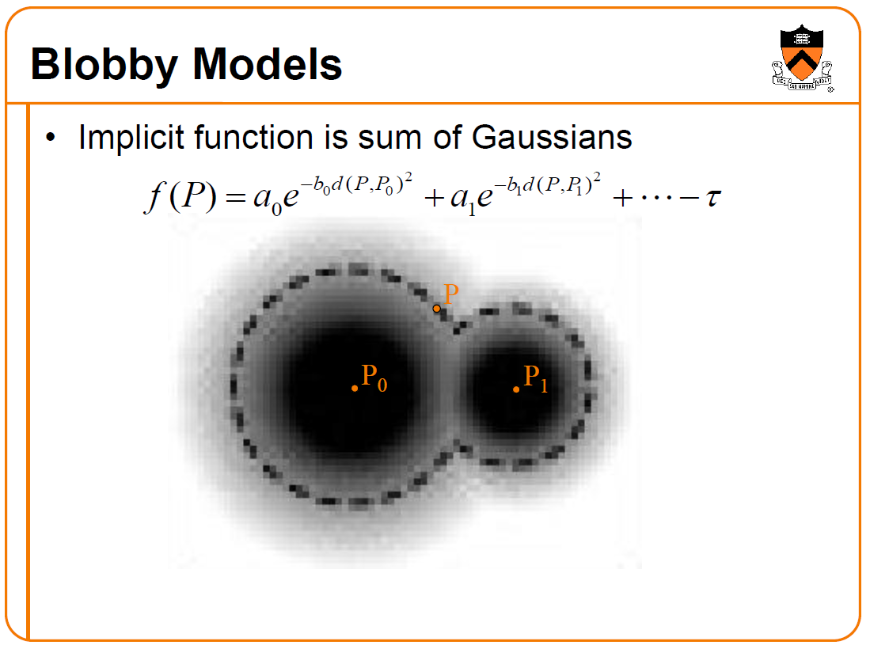
T. Funkhouser

Slide 20
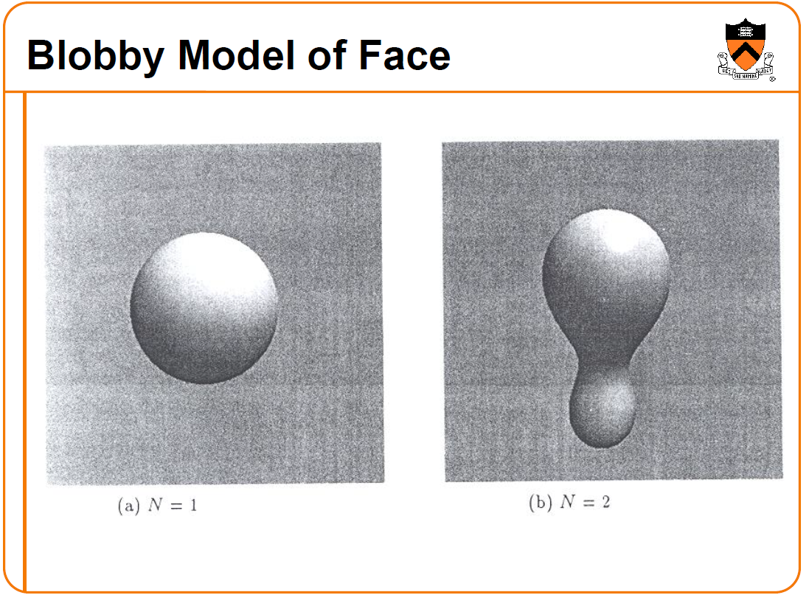
T. Funkhouser

Slide 21
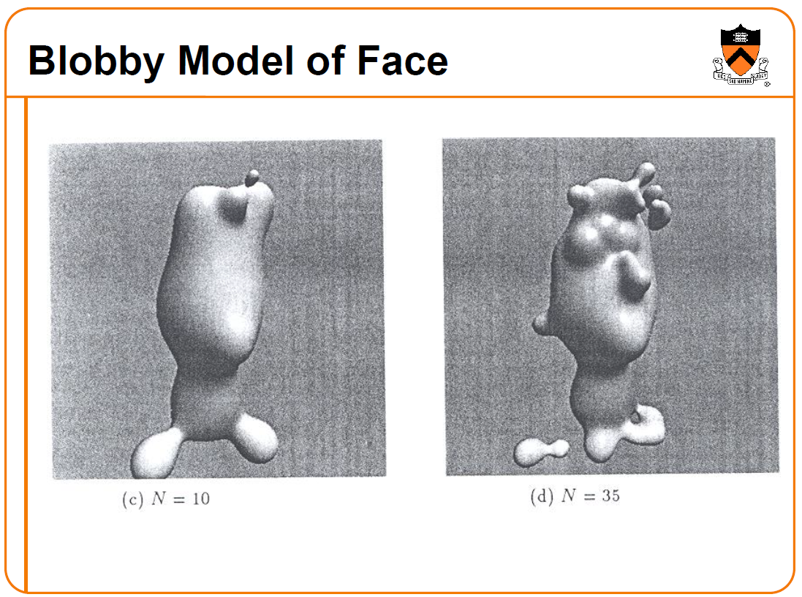
T. Funkhouser

Slide 22
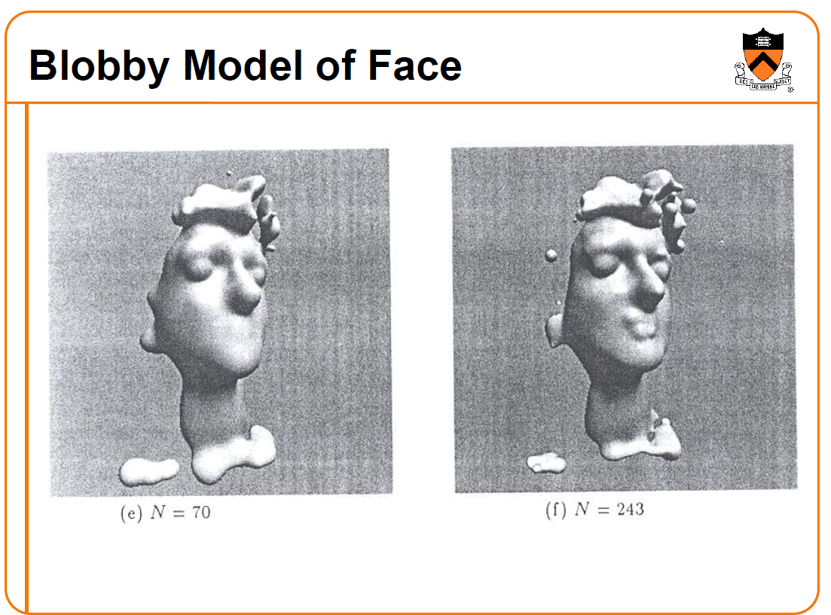
T. Funkhouser

Slide 23
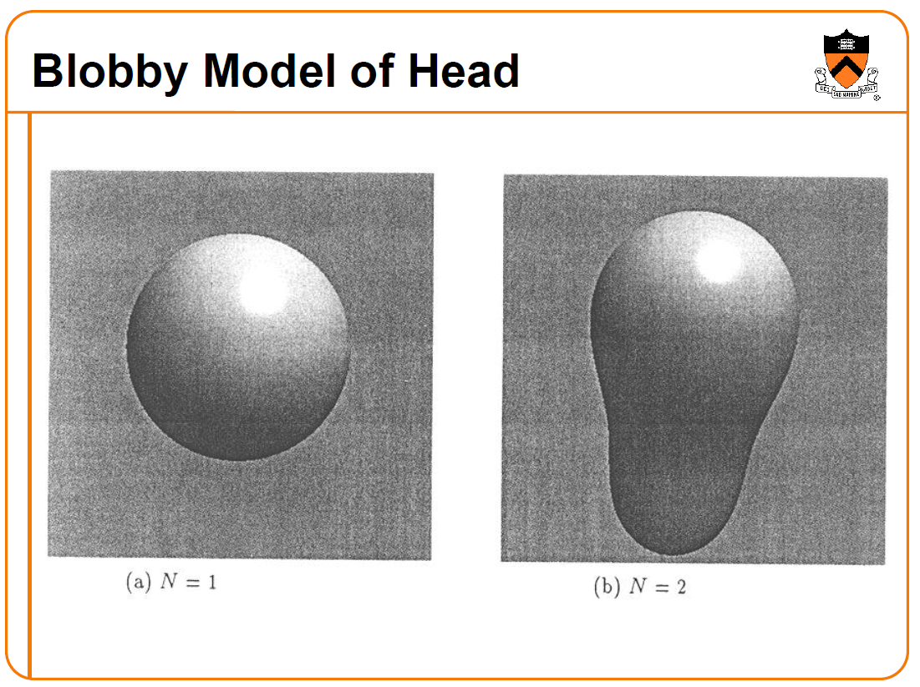
T. Funkhouser

Slide 24
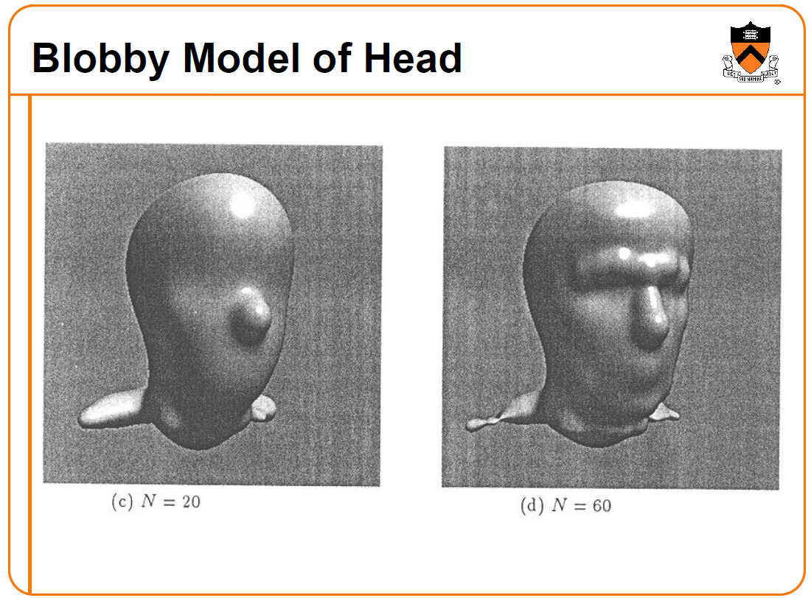
T. Funkhouser

Slide 25
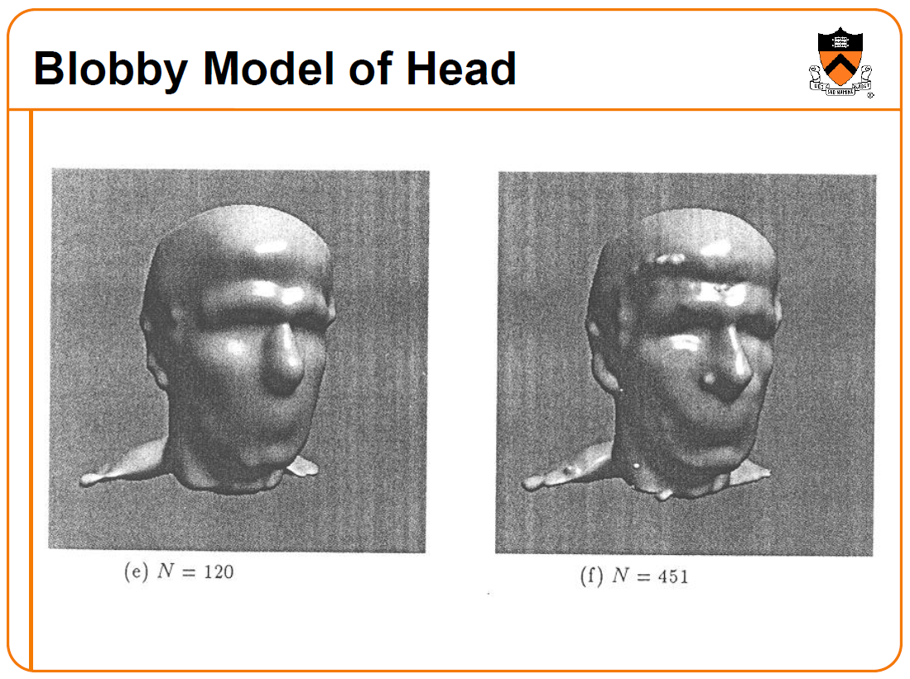
T. Funkhouser

Slide 26
Numpy Example

Slide 27
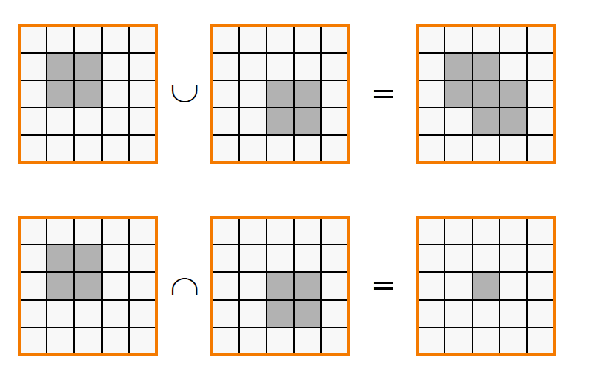
Voxel Boolean Shape Algebra
T. Funkhouser

Slide 28
Javascript CSG

